Slide 1

Importance of Design
Author: Prabhakar Nahak

Slide 2
Design Objective
Modularity
Maintainibility
Performance
Portability
Trackability
Usability
Deployment

Slide 3
High Level Design
High-level design paints an application’s structure in broad strokes. It identifies the system’s general environment (hardware, operating system, network, and so on) and architecture (such as monolithic, client/server, and service-oriented). It identifies the system’s major components such as reporting modules, databases, and top-level classes. It should also sketch out how the pieces of the system will interact.
The high-level design does not focus on the details of how the pieces of the application will work. Those details can be worked out later during low-level design and implementation.
high-level design focuses on what. Low-level design begins to focus on how.

Slide 4
Purpose of HLD
Understanding Environment and its surroundings.
Understanding Security aspects of the system.
Listing down the hardware details.
User interface if it’s a middle software the APIs.
Interactions between modules. Defining communication mechanism between.
Architecture Understanding about the overall system in an abstract manner. (Monolithic, Client-Server, Component based etc.,)
DFD. (Data Flow Diagram) If data flow goes via multiple layers.

Slide 5

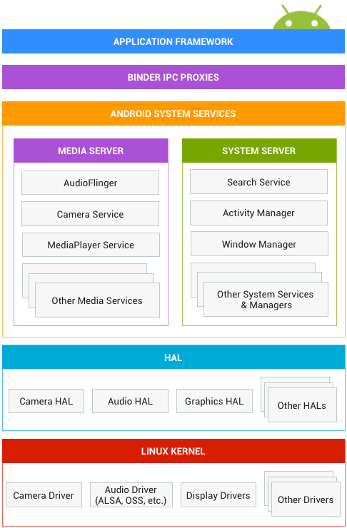




Slide 6
Low Level Design
LLD, also known as a detailed design, is used to design internals of the individual modules identified during HLD i.e. data structures and algorithms of the modules are designed and documented
Low-level design fills in some of the gaps to provide extra detail that’s necessary before developers can start writing code. It gives more specific guidance for how the parts of the system will work and how they will work together. It refines the definitions of the database, the major classes, and the internal and external interfaces.
LLD gives us more details about each module.

Slide 7
Purpose of LLD
Detailed Design to explain individual component.
Detailed description using which programmer can start writing programs.
Classes and their relationship with each other.
Pseudo code or Algorithm.
Objects and their corresponding properties.
OOPS: Inheritance hierarchies.
Detailed Refinement.

Slide 8
UML Diagrams
Structure Diagram
Class Diagram
Composite Structure Diagram
Component Diagram
Deployment Diagram
Object Diagram
Package Diagram
Profile Diagram

Slide 9

UML Diagrams Continued
Behavior Diagram
Activity Diagram
Use Case Diagram
State Machine Diagram
Interaction Diagram
Sequence Diagram
Communication Diagram
Interaction Overview Diagram
Timing Diagram

Slide 10
Interface Definition.
Following things need to keep in mind before defining an interface.
Identify the functionality that API need to perform.
For OOP, identify what would be the property of an object.
Identify IN/OUT parameters.
Follow the coding guidelines to create the interface.
Identify the error conditions and error codes which would be expected to come.
Identify the use cases before defining the interface and check whether it covers all use cases by given interface definition.

Slide 11
Reference Design document.
HLD Reference.
LLD Reference.
Process Page.
http://hobbes.allgolocal.com/index.php?n=Process.ProcessHome

Slide 12
Expectation From Design of Player Module
Use AllGo reference design document and create your own design for the player module.
Must features in your design.
Modularity. (Separate used libraries from your modules)
Traceability. (Requirement to design mapping).
Performance intensive.
Usability.

Slide 13
References.
https://learning.oreilly.com/library/view/beginning-software-engineering/9781118969175/c05.xhtml
https://learning.oreilly.com/library/view/beginning-software-engineering/9781118969175/c06.xhtml
https://source.android.com/devices/architecture
https://stackoverflow.com/questions/10297869/design-documents-high-level-and-low-level-design-documents
http://hobbes.allgolocal.com/index.php?n=Process.ProcessHome

